Slide 1
WebQuiz Prototype
Work in progress…

Slide 2
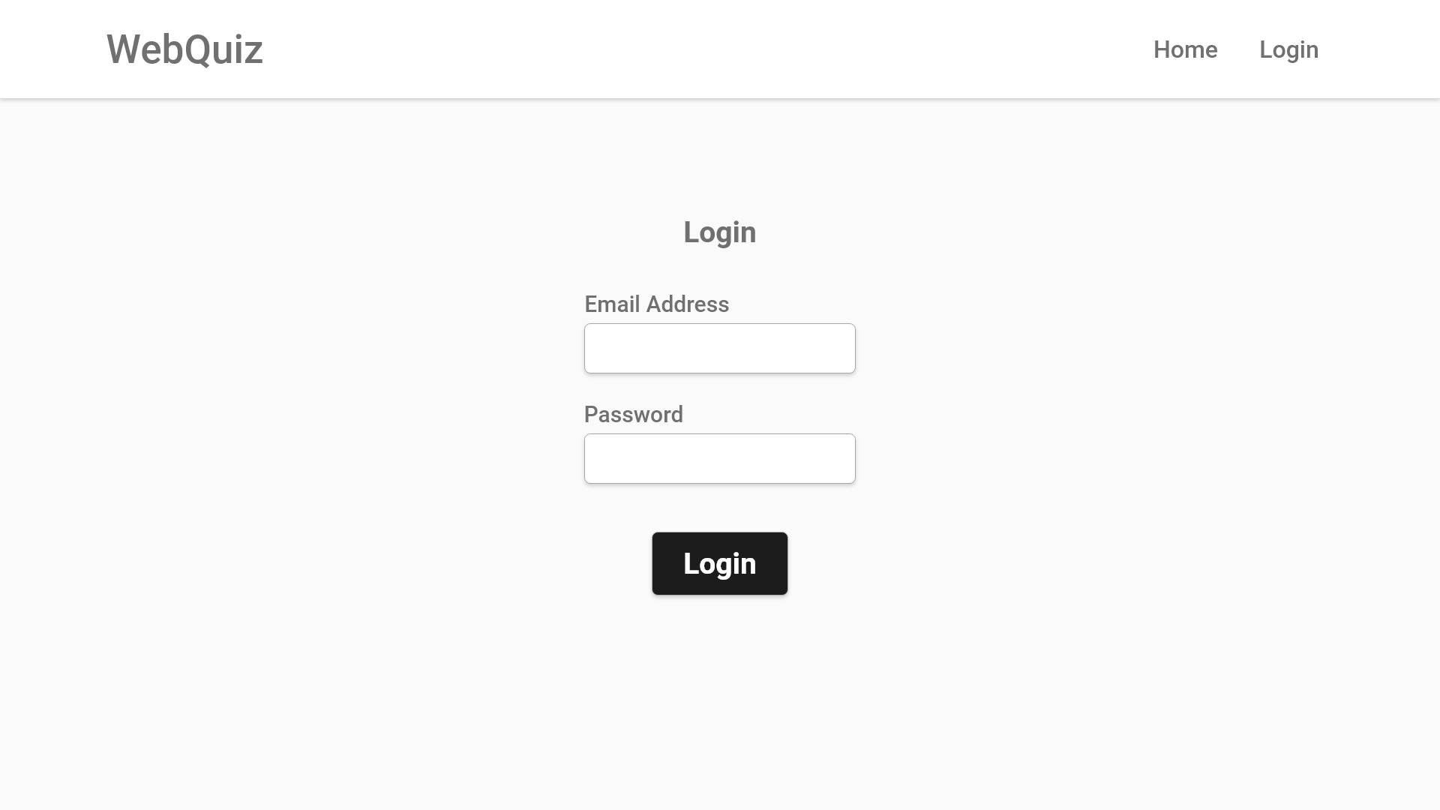
xyz@aber.ac.uk
User fills in both text boxes
***********
Click the button once forms are filled

Slide 3
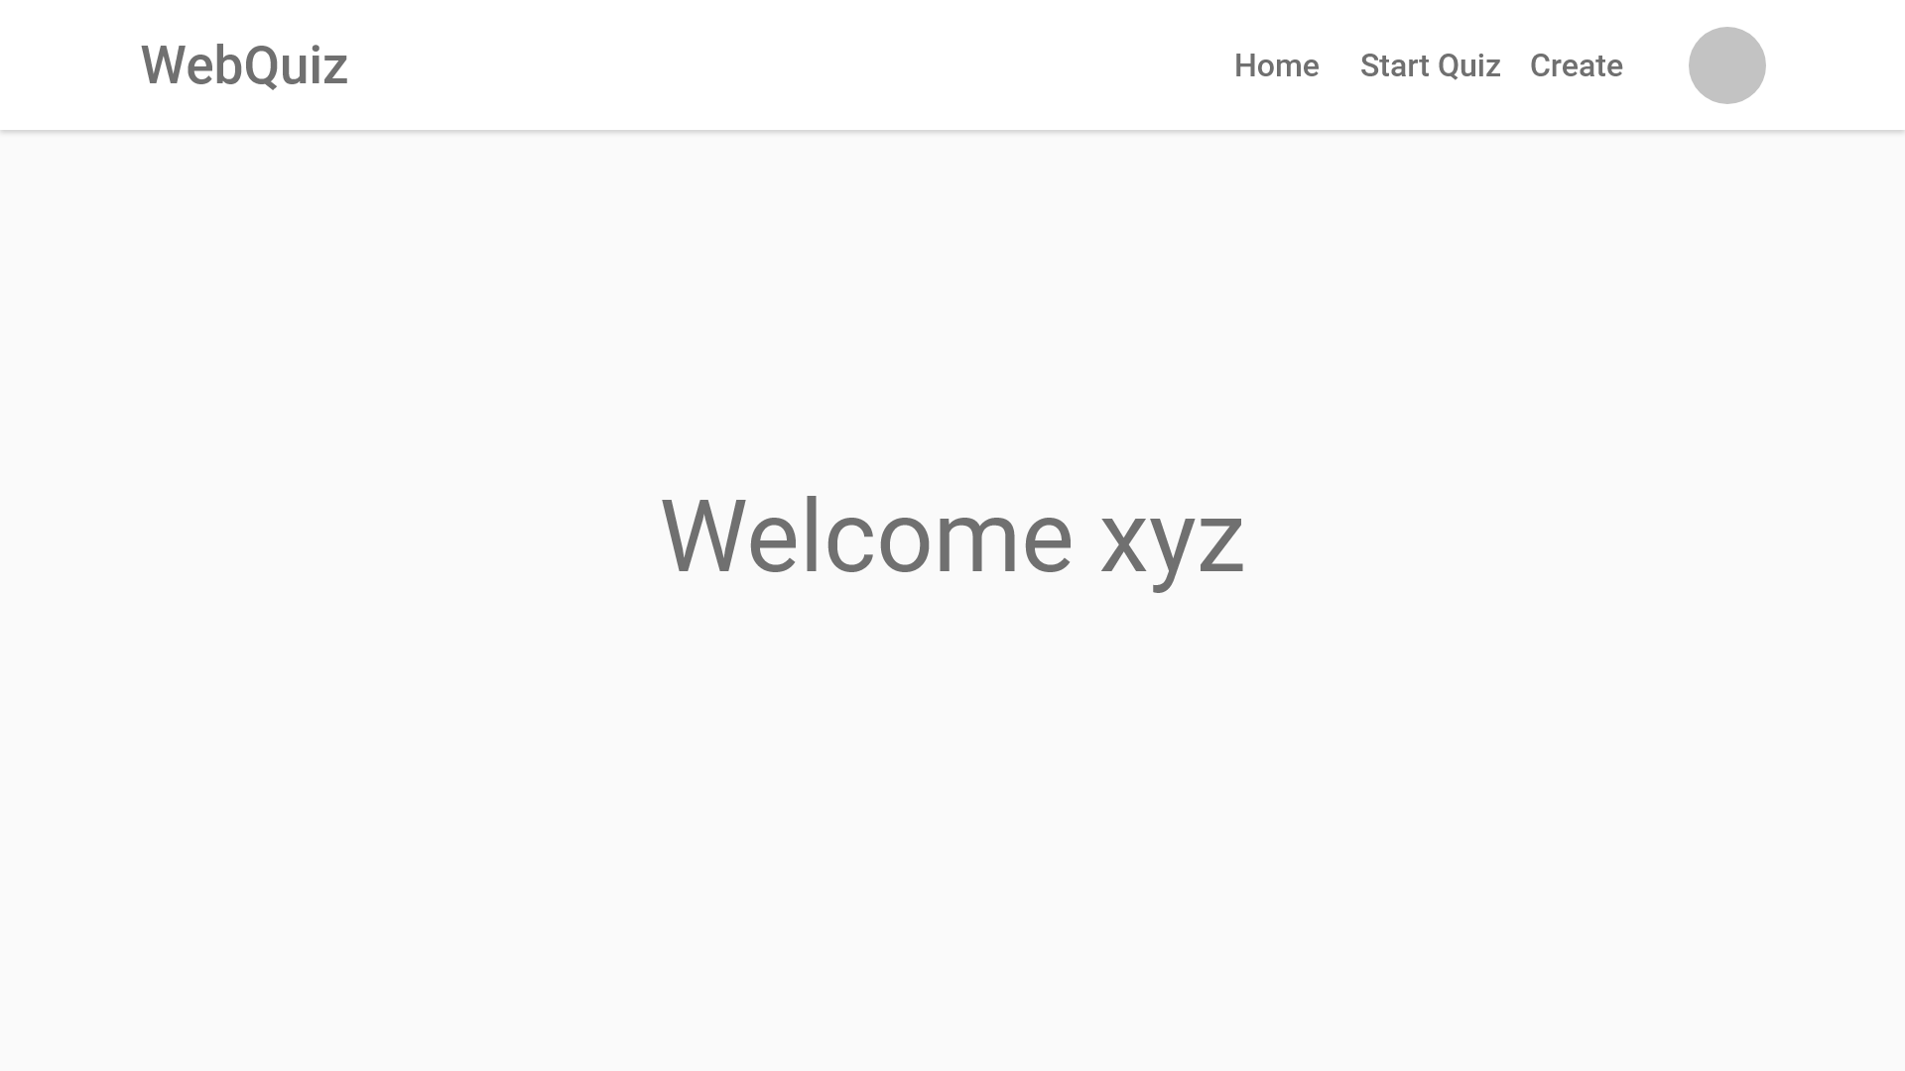
Splash screen containing username. Transitions after a couple of seconds

Slide 4
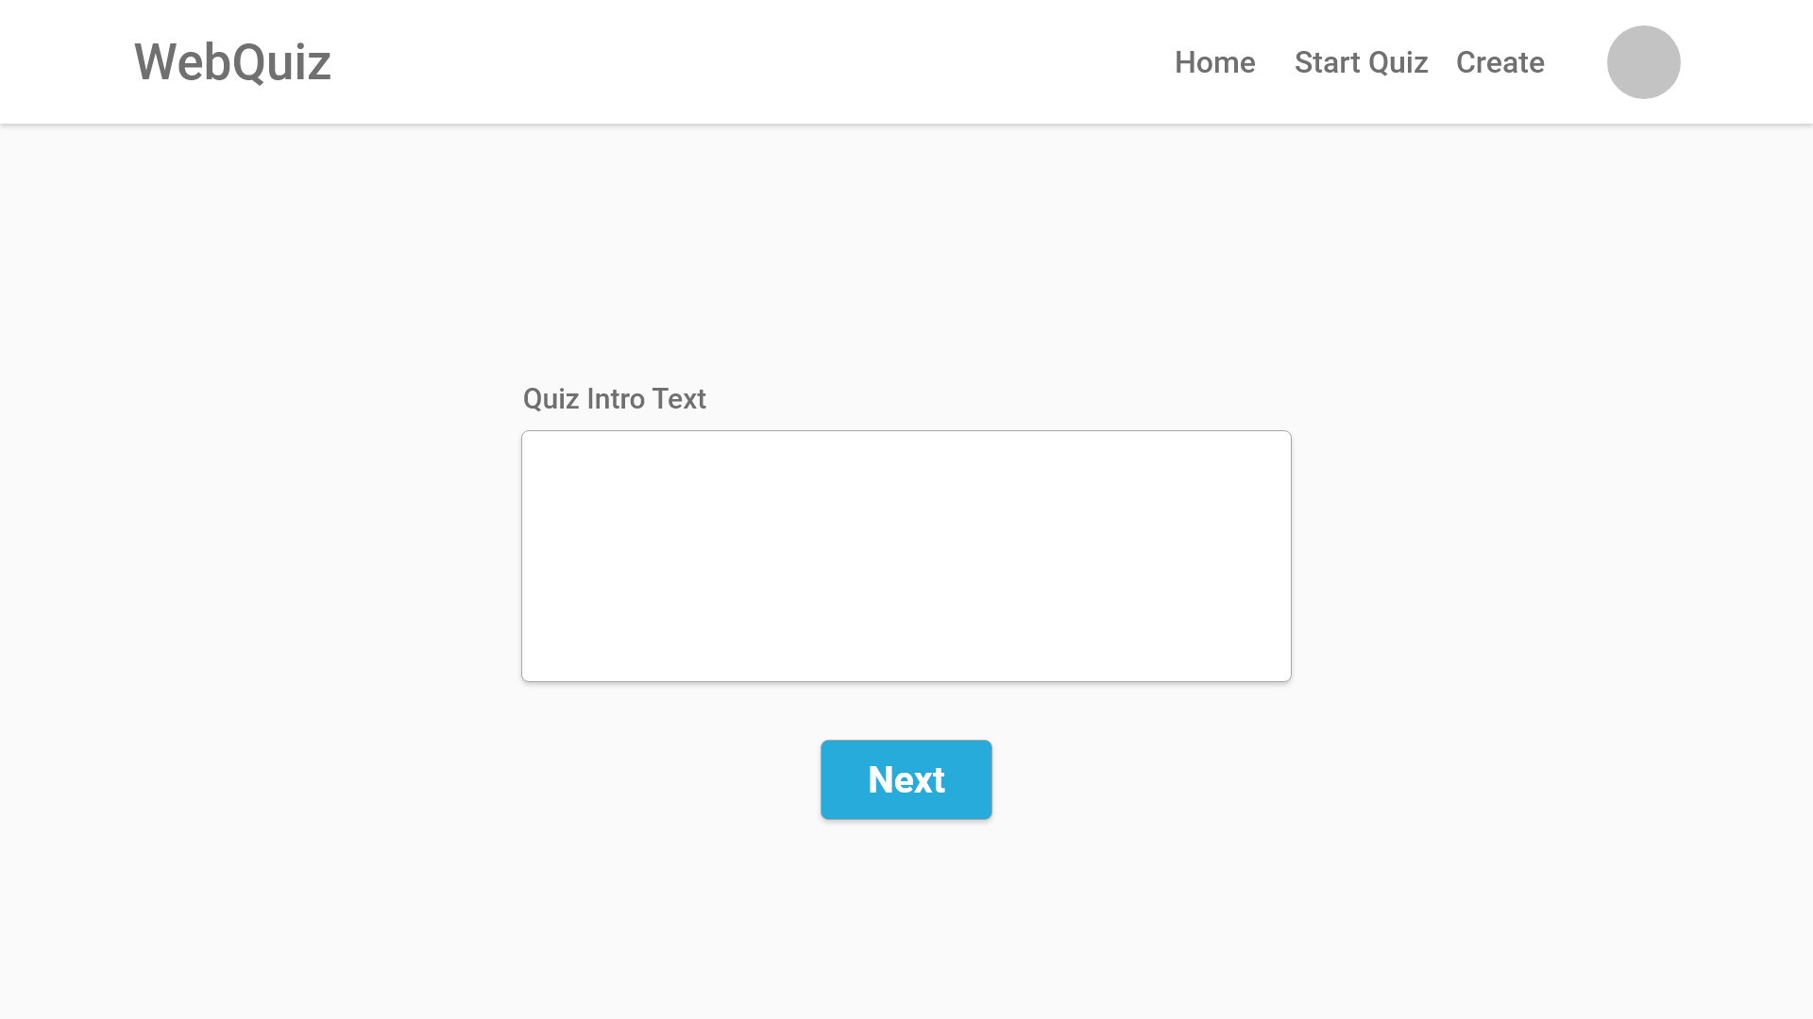
French Language 13
This Quiz utilizes multiple choice and free written questions. Please use dropdowns and fill in textboxes as necessary.
User enters an introduction for the quiz
Once the textbox is filled the user clicks next to continue

Slide 5
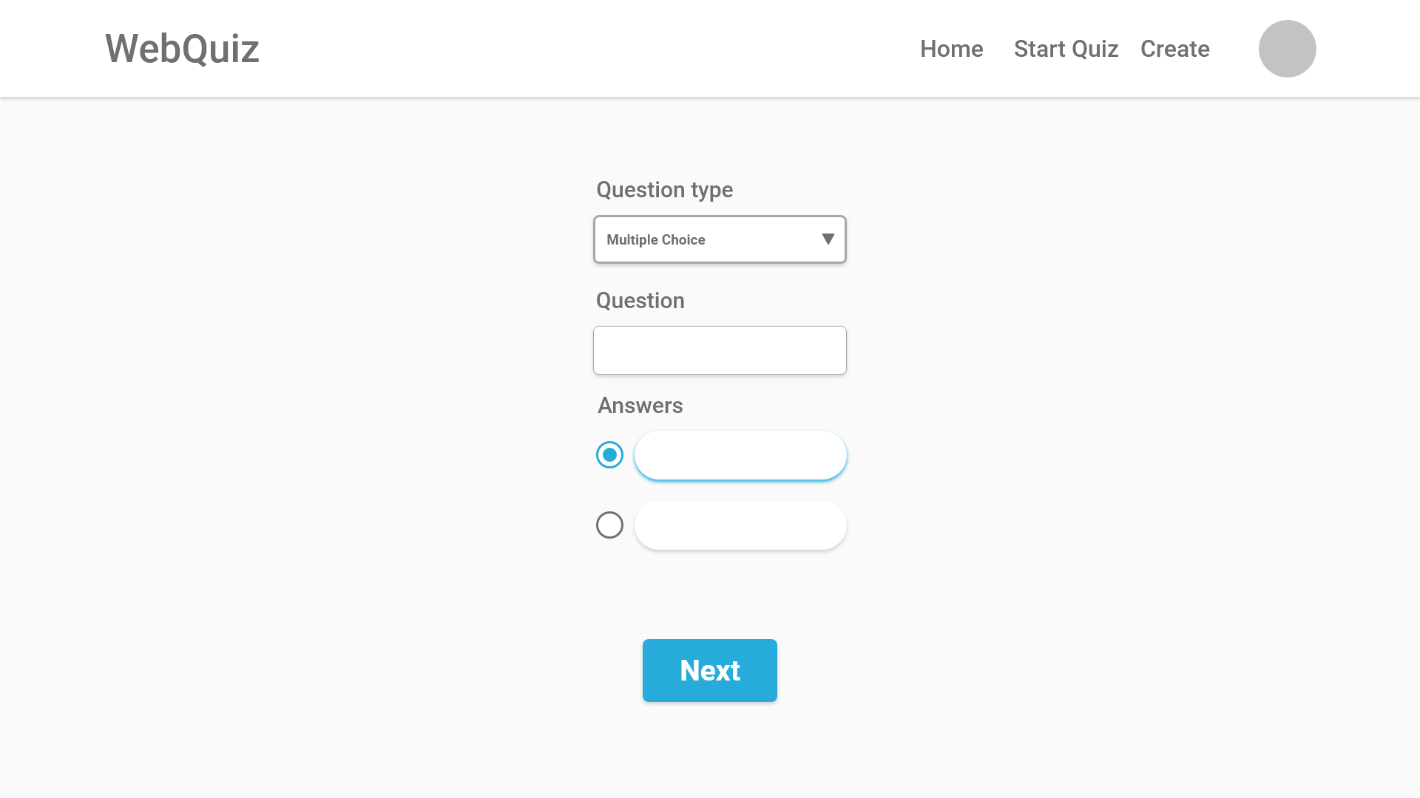
User selects a question type from the dropdown menu
Enter a question in the textbox
What is cat in French?
Fill in the textboxes and check the correct box
Chien
Chat

Slide 6
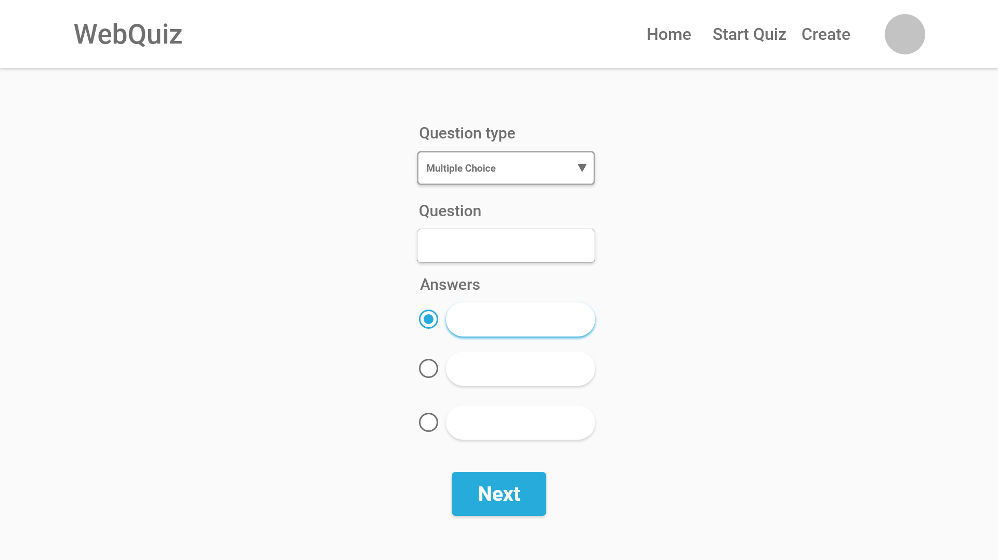
User selects a question type from the dropdown menu
Enter a question in the textbox
What is cat in French?
Fill in the textboxes and check the correct box
Chien
Chat
Cheval

Slide 7
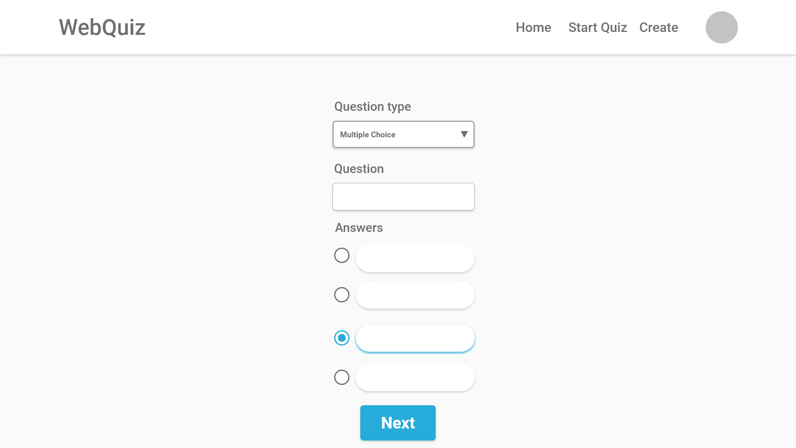
User selects a question type from the dropdown menu
Enter a question in the textbox
What is cat in French?
Fill in the textboxes and check the correct box
Chien
Chat
Cheval
Fille

